Slide 1
PaNOSC and Data Storage across the EOSC
Brian Matthews
Leader, Data Science and Technology Group
Scientific Computing Department
brian.matthews@stfc.ac.uk

Slide 2



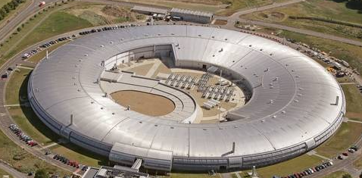




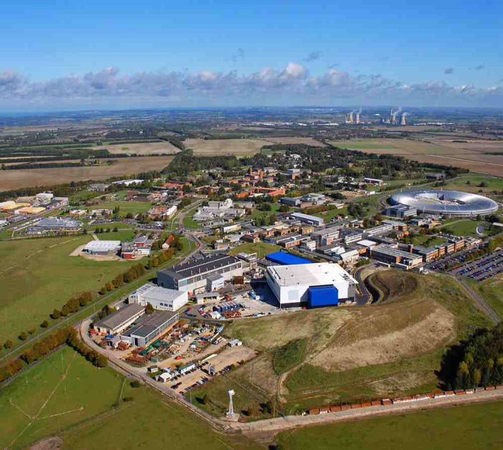


SCD’s Science Communities
Environment
SKA
Life Sciences
DAFNI
Astronomy
JASMIN
Diamond
CERN
IRIS
ISIS
Materials
Sciences
Fundamental Physics

Slide 3
Services which SCD provides
Tailored data storage solutions for particular communities
WLCG: dedicated data transfer links
Into Tape (CASTOR) and Disk (CEPH)
JASMIN (Environment)
Elastic Tape
Diamond
Bespoke pipeline into Tape storage
ICAT as a file catalogue
EOSC projects (SeaDataCloud, EOSC-Hub)
B2Safe, B2Share onto disc,
File transfer:
GOL
FTS – now being incorporated into the EGI/EOSC offering

Slide 4
What is SCD doing in PaNOSC ?
Effort
c. 0.5FTE p.a. over 4 years
Helping provide the distributed data infrastructure (within EGI) to support the facilities
Tools for moving large data sets around
Providing data archiving services
Storing c. 1PB of data per year for the 4 years.
ILL a major driver for this.
No hardware
Agreement in principle from IRIS consortium and possibly elsewhere
Fits closely with what we do for UK facilities.
As part of EOSC integration

Slide 5
Levels of Service
Archive
Back up copy, controlled and used by facilities operations.
Copy of local archive, minimal additional metadata
Gives a level of assurance for data preservation
Repository
User access to download data
User AAI for access
Richer user interface
Metadata catalogue for search and access
For load balancing or supporting local (e.g. UK) users
Platform
Combine with other data resources e.g. data sets from other facilities.
Access to compute resources
Support workflows.
Requires different funding model

Slide 6


Technologies
WLCG
CASTOR onto tape (currently – but being phased out)
AWS S3 interface onto CEPH (Echo)
Diamond
Dedicated pipeline to store onto Tape
StorageD and ICAT
Environment
ElasticTape – can move between disc and tape storage
EUDat tools
B2Safe
based on IRODS – our instance is disc based.
Long term storage of large data sets
Policy enforcement
B2Share
Based on Invenio
Smaller data set repository tool
Richer metadata

Slide 7
Requirements
What are the requirements of PANOSC partners
How much data?
When will the storage be needed?
Who will be responsible?
Who will access?
What kind of mode of service is needed?
Archive to begin with, explore repository
Disc or tape or combination
Tools for moving data
FTS
AAI
Umbrella ? EGI-Checkin
SLA
Long term business model

Slide 8
Suggested approach
M1-9: Discussion with PANOSC Partners to determine requirements and preferred technology
M6-15: Develop and deploy archiving prototype and move from one partner (ILL ?)
M13-24: embed the Archive and extend to further partners
M18-36: explore approaches to data repository (B2Safe/B2Share)
M24-48: operations
We have requested tape resources from the beginning and additional disc from year 2

